Slide 1
Real time recompilation of running JavaScript
Peter van der Zee
JSConf.us 2013

Slide 2
Whois
Peter van der Zee
JavaScript developer
Netherlands
qfox.nl
@kuvos
surfly.com
"Remote desktop in the browser"
JS1K
ZeonJS
ZeParser
HeatFiler

Slide 3

Demonstration

Slide 4
So...
Compile JS on the fly
Maintain access to closures
No restart of app required
Lazy evaluation
Generic approach

Slide 5
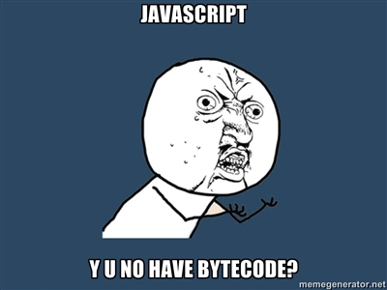
Compile in JS?

Slide 6

Live coding woohoo

Slide 7
Issues
function arguments
closures
function declarations
named function expressions
performance

Slide 8
Direct vs indirect eval
Call from global
Call from local / renamed global
Function
setInterval and setTimeout

Slide 9
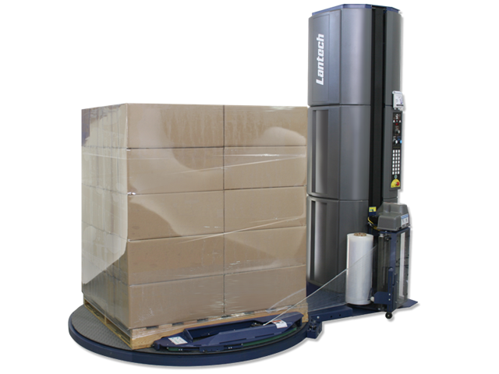
Basically

Slide 10
Open issues
Big:
Inserting new functions
Minor:
Variable clashes
Hard to explain

Slide 11
Code
http://github.com/qfox/recompiler

Slide 12

Questions?

